Slide 1
COMP1201
Algorithms
Lecture 2 Matching
Jie Zhang
jie.zhang@soton.ac.uk
Electronics and Computer Science
University of Southampton

Slide 2
Matching
Project students – Supervisors
Graduates – Companies
Passengers – Drivers
An obvious objective in applications: Increasing the cardinality of the matching or even finding a maximum matching.

Slide 3
Matching
A matching in a graph is a set of edges without common vertices. I.e., it is an independent edge set.
A vertex set U ⊆ V is covered by a matching M if every vertex in U is incident with an edge in M.
The vertices in U are called matched (by M)
Vertices not incident with any edge of M are unmatched / free.

Slide 4
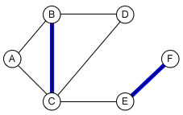
Matching
M is a maximal matching: M + e is not a matching, ∀ e ∉ M. That is, M is maximal if it is not a subset of any other matching.
A maximum (cardinality) matching is a matching that contains the largest possible number of edges.
Two remarks:
Maximal matching and Maximum matching in a graph may not be unique.
M is maximum ⇒ M is maximal, but not the other way round.

Slide 5
Maximal Matching Algorithms
Maximal Matching
INPUT: Graph G, initial matching M (e.g. empty) on G
OUTPUT: a maximal matching on G
M ← ∅
While ∃ edge e, s.t. e does not have any vertex in common with edges in M
M ← M ∪ e
Return M
Myopic, ignoring features of the graph and current matching
Finds a maximal matching but not necessarily maximum
In fact, in any graph,
the size of any maximal matching ≥ half of the size of a maximum matching.
Any better ideas in searching for a maximum matching?

Slide 6
A simple idea
Idea: in the following scenario the “symmetric difference” of M is a matching with one more edge than that of M.
1
1
7
7
2
2
→
3
3
6
6
4
5
4
5
Matching M = {23, 45}
Matching M’ = {12, 34, 56}
|M’| = |M| +1

Slide 7
Augmenting Path
Given a graph G = (V, E) and a matching M. A path P is called an augmenting path for M if:
The two end points of P are unmatched by M
The edges of P alternate between edges ∈ M and edges ∉ M
1
Matching
M = {23, 45}
Augmenting path:
12 → 23 → 34 → 45 → 56
7
2
3
6
4
5

Slide 8

From Maximal to Maximum
Maximal Matching
INPUT: Graph G, initial matching M (e.g., empty) on G
OUTPUT: a maximal matching on G
M ← ∅
While ∃ edge e, s.t. e does not have any vertex in common with edges in M
M ← M ∪ e
Return M
Berge’s Theorem: A matching M is maximum iff it has no augmenting path.
Maximum Matching
INPUT: Graph G, initial matching M on G
OUTPUT: a maximum matching on G
M ← ∅
While ∃ an augmenting path P w.r.t. M
Flip the edges in P, i.e., perform the symmetric difference operation
Return M

Slide 9
An intuitive idea for the subroutine
Graph traversal
Given a matching M, in searching for an augmenting path, we start with an unmatched vertex v₀ as the root and run a Depth First Search (DFS).
A path v₀v₁v₂…v_{2k}v_{2k+1} is an augmenting path if
v₀v₁, v₂v₃, … , v_{2k}v_{2k+1} ∉ M, and
v₁v₂, v₃v₄, … , v_{2k-1}v_{2k} ∈ M.

Slide 10
An example
6
Given the matching {23, 45}
Start with vertex 1 as the root and run DFS.
1 → 2 → 3 → 4 → 5 → 6
is an augmenting path.
BUT, what if DFS outputs
1 → 5 → 4 → 3 → 2 and 1 → 5 → 6
This idea does not guarantee that an
augmenting path will be found if there exists one.
Why would these cases happen?
Because of the odd cycles
4
5
Lucky
1
Unlucky
3
2

Slide 11
Odd cycle is pivotal
6
In an odd cycle there will be two unmatched edges that share a vertex.
Edges 12 and 15 share vertex 5
If the DFS starts from this vertex and the cycle is traversed the “unlucky” direction we will miss the augmenting path.
We would not have these troubles if there was no odd cycles!
4
5
1
3
2

Slide 12

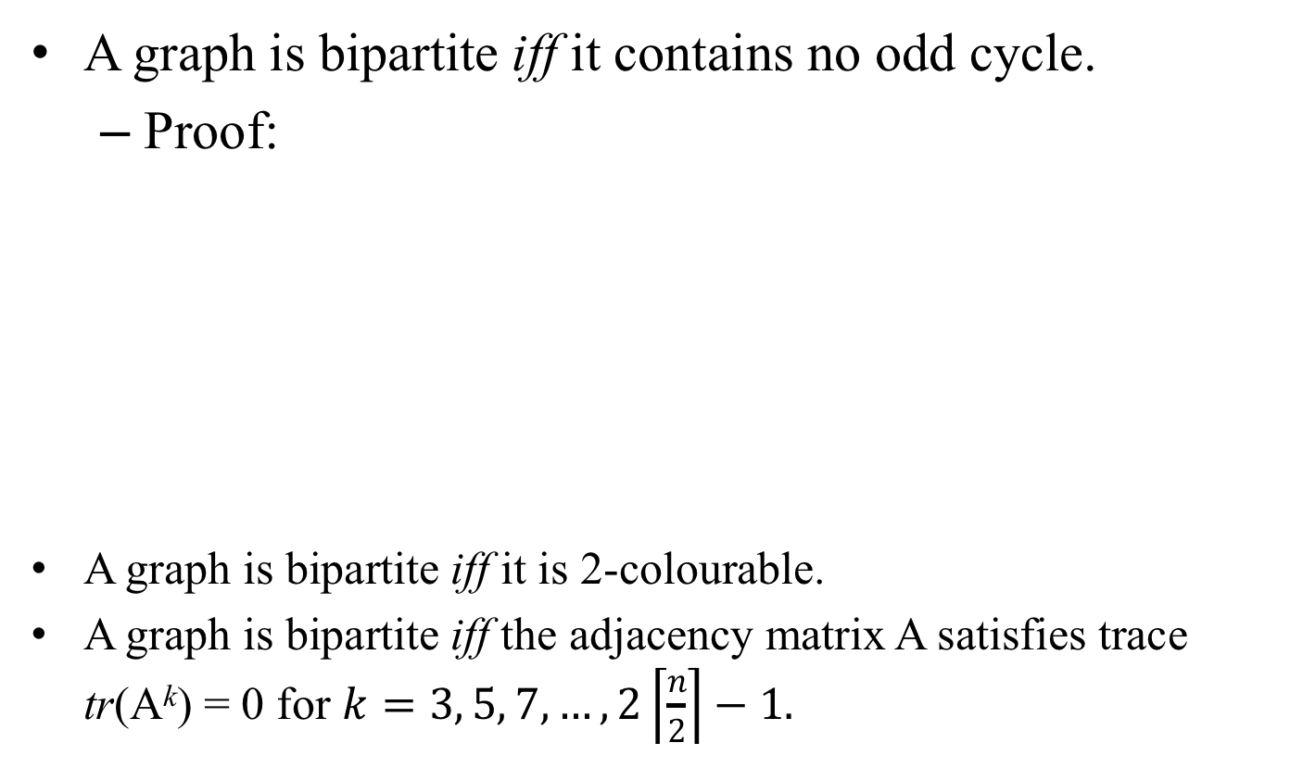
Bipartite Graphs
A graph is bipartite iff it contains no odd cycle.
Proof:
A graph is bipartite iff it is 2-colourable.
A graph is bipartite iff the adjacency matrix A satisfies trace tr(A^{k}) = 0 for $k=3, 5, 7, …, 2\left\lceil \frac{n}{2}\right\rceil −1.$

Slide 13
Bipartite Maximum Matching
Maximum Matching (G, V, E)
M ← ∅
While ∃ an augmenting path P w.r.t. M
Flip the edges in P, i.e., perform the symmetric difference operation
Return M
If G is a bipartite graph
Maximum Matching (G, M)
M ← ∅
Start DFS at a unmatched vertex
While ∃ an augmenting path P w.r.t. M
Flip the edges in P
Return M

Slide 14
Bipartite Maximum Matching
Start with arbitrary matching (in red)

Slide 15
Bipartite Maximum Matching
Pick a free vertex in the bottom, run DFS

Slide 16
Bipartite Maximum Matching
Alternate unmatched/matched edges, until an augmenting path is found

Slide 17
Bipartite Maximum Matching
Flip!

Slide 18
Repeat
Pick another free vertex in the bottom, run DFS
No more augmenting path, just a pair of free vertices; match them

Slide 19
An answer
Since we cannot find any augmenting path, stop!

Slide 20
Time Complexity of Bipartite Maximum Matching
Maximum Matching (G, M)
M ← ∅
Start DFS at a unmatched vertex
While ∃ an augmenting path P w.r.t. M
Flip the edges in P
Return M
≤ |V|
≤ |E|
In total, worst-case, O(|V| |E|)

Slide 21
An improvement
Hopcroft-Karp Algorithm
“Let’s find augmenting paths in parallel for all free vertices in every iteration.”
When augmenting the current matching, do it with maximal set of vertex disjoint shortest paths (using DFS)
As a result, only O(|V|^{0.5}) iterations are needed.
Using such approach, the time complexity is improved to O(|V|^{0.5} |E|)

Slide 22
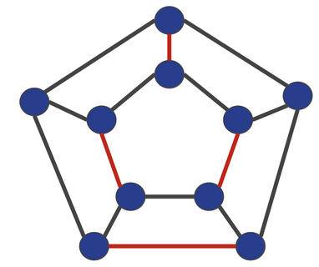
Exercise 1
Is this a maximal matching? Is it a maximum matching?
e₁
e₁₂
e₂
e₁₁
e₆
e₇
e₁₃
e₁₀
e₈
e₉
e₃
e₅
e₁₅
e₁₄
e₄

Slide 23
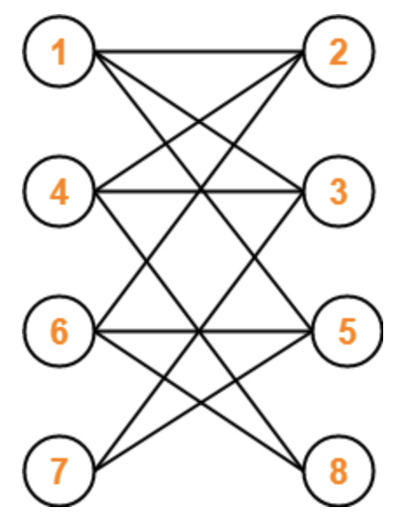
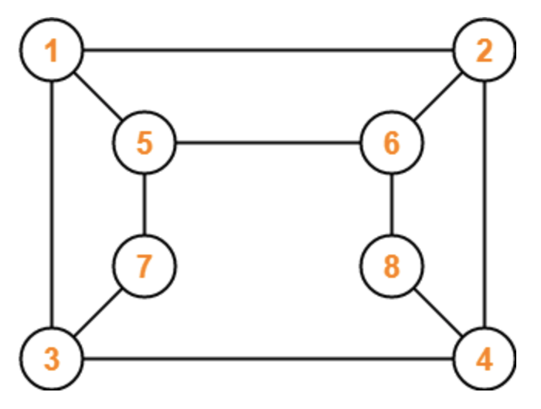
Exercise 2
Is this a bipartite graph or not?
The maximum number of edges in a bipartite graph on 20 vertices is?

Slide 24
Exercise 3
Implement the algorithm to find a maximum matching of the following bipartite graph

Slide 25
Exercise 3
Implement the algorithm to find a maximum matching of the following bipartite graph

Slide 26
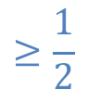
Roadmap for developing Maximum Matching Algorithms
Maximal Matching Alg
$$≥\frac{1}{2}$$
Berge’s Theorem
Maximum Matching Alg
(subroutine of finding augmenting paths)
Bipartite or not? BFS/DFS
Bipartite
Non-bipartite
Graph traversal + “Symmetric difference”
Contract + Expand
odd cycles

Slide 27

Maximum matching in general graph
Given a non-bipartite graph G and a matching M, a blossom is an odd cycle (length 2k+1) with k edges belong to M, and one of its vertices v is such that there exists an alternating path of even length from v to an unmatched vertex w.

Slide 28
Shrinking a blossom

Slide 29
Shrinking and expanding a blossom
e
f
a
d
g
b
c
e
f
a
d
g
b
c

Slide 30
Edmonds’ Blossom Algorithm
Maximum Matching (G, M)
M ← ∅
Start graph traversal at a unmatched vertex
if ∃ an augmenting path P w.r.t. M
Flip the edges in P
Else find a blossom B and shrink it
find a maximum matching M/B in G/B
expand B, obtain a maximum matching M in G
Return M
Obtain an equivalent smaller problem
Thm: M is a maximum matching in G iff M/B is a maximum matching in G/B.

Slide 31
Edmonds’ Blossom Algorithm
Maximum Matching (G, M)
M ← ∅
Start graph traversal at a unmatched vertex
if ∃ an augmenting path P w.r.t. M
Flip the edges in P
Else find a blossom B and shrink it
find a maximum matching M/B in G/B
expand B, obtain a maximum matching M in G
Return M
O(n) calls
O(mn) or O(n³)
Time complexity: O(mn²) or O(n⁴)

Slide 32
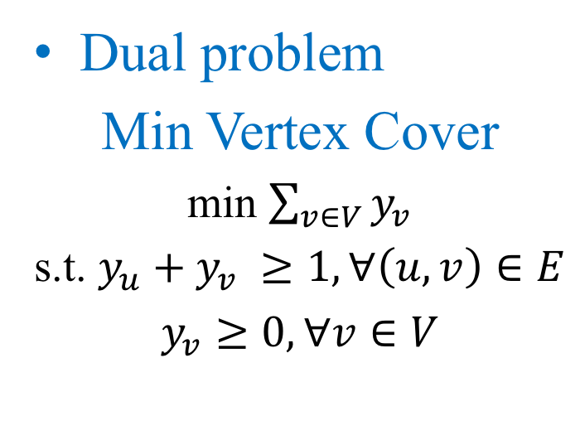
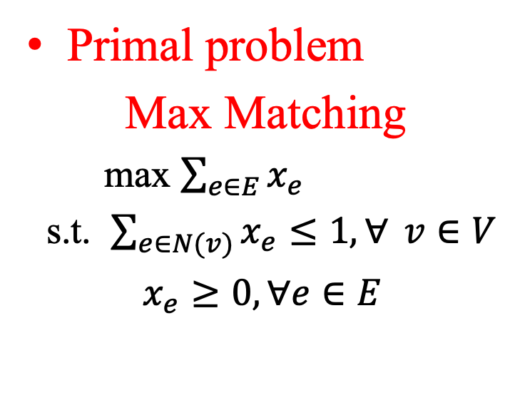
An optimization angle on maximum matching and its dual problem
Primal problem
Max Matching
max $\sum_{e∈E}{x_{e}}$
s.t. $\sum_{e∈N(v)}{x_{e}≤1, ∀} v∈V$
$x_{e}≥0, ∀e∈E$
Dual problem
Min Vertex Cover
min $\sum_{v∈V}{y_{v}}$
s.t. $y_{u}+y_{v} ≥1, ∀\left(u,v\right)∈E$
$y_{v}≥0, ∀v∈V$
König [1931]:
In a bipartite graph,
the size of a maximum matching = the size of a minimum vertex cover

Slide 33
Algorithm Design Pathway
Brute-force
Often expensive
Greedy
Myopic; sometimes local optimum is global optimum, sometimes not
Heuristic
Often trade-off optimality, completeness, accuracy
Optimal algorithm
Needs insights and rigor proofs for taking a shortcut
Polynomial-time Approximation Scheme (PTAS)
Competitive analysis
Dynamic programming
Careful brute-force
etc

